Slide 1
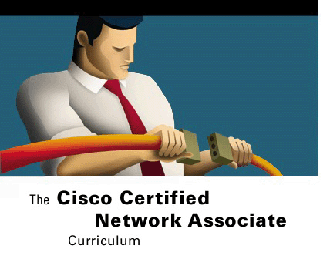



CABLING LANS AND WANS
Networking Basics
Version 3.0
Cisco Regional Networking Academy

Slide 2
Objectives
Identify characteristics of Ethernet networks.
Identify straight-through, crossover, and rollover cables.
Describe the function, advantages, and disadvantages of repeaters, hubs, bridges, switches, and wireless network components.
Describe and differentiate between serial, Integrated Services Digital Network (ISDN), digital subscriber line (DSL), and cable modem WAN connections.

Slide 3
Table of Content
1 | Cabling the LAN
2 | Cabling the WAN

Slide 4

CABLING THE LAN

Slide 5


LAN Physical Layer
Data link
Layer
IEEE 802.2
Ethernet
100Base-TX
100Base-FX
10Base5
10Base2
10Base-T
10Base-F
Physical
Layer
DIX
IEEE 802.3
IEEE 802.3u
Notes:
Various symbols are used to represent media types. Token Ring is represented by a circle. Fiber Distributed Data Interface (FDDI) is represented by two concentric circles and the Ethernet symbol is represented by a straight line. Serial connections are represented by a lightning bolt.
Each computer network can be built with many different media types. The function of media is to carry a flow of information through a LAN. Wireless LANs use the atmosphere, or space, as the medium. Other networking media confine network signals to a wire, cable, or fiber. Networking media are considered Layer 1, or physical layer, components of LANs.
Each media has advantages and disadvantages. Some of the advantage or disadvantage comparisons concern:
Cable length
Cost
Ease of installation
Susceptibility to interference
Coaxial cable, optical fiber, and even free space can carry network signals. However, the principal medium that will be studied is Category 5 unshielded twisted-pair cable (Cat 5 UTP) which includes the Cat 5e family of cables.
Many topologies support LANs, as well as many different physical media. Figure shows a subset of physical layer implementations that can be deployed to support Ethernet.
Ethernet is the most widely used LAN technology. Ethernet was first implemented by the Digital, Intel, and Xerox group, referred to as DIX. DIX created and implemented the first Ethernet LAN specification, which was used as the basis for the Institute of Electrical and Electronics Engineers (IEEE) 802.3 specification, released in 1980. Later, the IEEE extended 802.3 to three new committees known as 802.3u (Fast Ethernet), 802.3z (Gigabit Ethernet over Fiber), and 802.3ab (Gigabit Ethernet over UTP).

Slide 6
advantage or disadvantage comparisons concern
Cable length
Cost
Ease of installation
Susceptibility to interference
Notes:
Each media has advantages and disadvantages. Some of the advantage or disadvantage comparisons concern:
Cable length
Cost
Ease of installation
Susceptibility to interference

Slide 7
Ethernet In The Campus
An Ethernet speed of 10 Mbps can be used at the user level to provide good performance.
Fast Ethernet is used as the link between user and network devices.
To enhance client-server performance across the campus network and avoid bottlenecks, Fast Ethernet can be used to connect enterprise servers.
Fast Ethernet or Gigabit Ethernet, as affordable, should be implemented between backbone devices
Notes:
Network requirements might dictate that an upgrade to one of the faster Ethernet topologies be used. Most Ethernet networks support speeds of 10 Mbps and 100 Mbps.
The new generation of multimedia, imaging, and database products, can easily overwhelm a network running at traditional Ethernet speeds of 10 and 100 Mbps. Network administrators may consider providing Gigabit Ethernet from the backbone to the end user. Costs for installing new cabling and adapters can make this prohibitive. Gigabit Ethernet to the desktop is not a standard installation at this time.
In general, Ethernet technologies can be used in a campus network in several different ways:
An Ethernet speed of 10 Mbps can be used at the user level to provide good performance. Clients or servers that require more bandwidth can use 100-Mbps Ethernet.
Fast Ethernet is used as the link between user and network devices. It can support the combination of all traffic from each Ethernet segment.
To enhance client-server performance across the campus network and avoid bottlenecks, Fast Ethernet can be used to connect enterprise servers.
Fast Ethernet or Gigabit Ethernet, as affordable, should be implemented between backbone devices.

Slide 8
Ethernet Media And Connector Requirements
Media | 50Ω thin-net | 50Ω thick-net | UTP Cat 3,4,5 | 62.5/50 mul- fiber | Single-mode fiber | STP
Max. segment length | 185m | 500m | 100m | ?????? | 10Km | 25m
Topology | Bus | Bus | Star | Star | Star | Star
Conn. | BNC | AUI | RJ-45 | SC/MIC | ST | RJ-45
Notes:
Before selecting an Ethernet implementation, consider the media and connector requirements for each implementation. Also, consider the level of performance needed by the network. The cables and connector specifications used to support Ethernet implementations are derived from the Electronic Industries Association and the Telecommunications Industry Association (EIA/TIA) standards body. The categories of cabling defined for Ethernet are derived from the EIA/TIA-568 (SP-2840) Commercial Building Telecommunications Wiring Standards.
Figure compares the cable and connector specifications for the most popular Ethernet implementations. It is important to note the difference in the media used for 10-Mbps Ethernet versus 100-Mbps Ethernet. Networks with a combination of 10- and 100-Mbps traffic use UTP Category 5 to support Fast Ethernet.

Slide 9
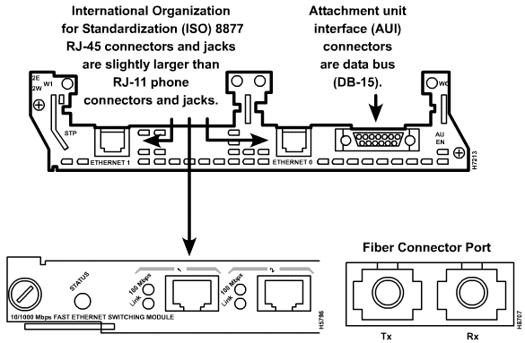
Connection Media
Notes:
Figure illustrates the different connection types used by each physical layer implementation. The registered jack (RJ-45) connector and jack are the most common. RJ-45 connectors are discussed in more detail in the next section.
In some cases the type of connector on a network interface card (NIC) does not match the media that it needs to connect to. As shown in Figure , an interface may exist for the 15-pin attachment unit interface (AUI) connector. The AUI connector allows different media to connect when used with the appropriate transceiver. A transceiver is an adapter that converts one type of connection to another. Typically, a transceiver converts an AUI to RJ-45, coax, or fiber optic connector. On 10BASE5 Ethernet, or Thicknet, a short cable is used to connect the AUI with a transceiver on the main cable.

Slide 10
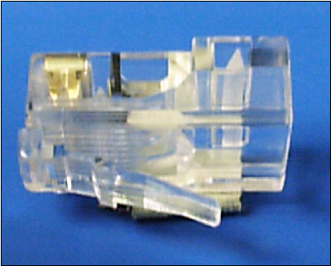
RJ-45 Plug
Notes:
EIA/TIA specifies an RJ-45 connector for UTP cable. The letters RJ stand for registered jack, and the number 45 refers to a specific wiring sequence. The RJ-45 transparent end connector shows eight colored wires. Four of the wires carry the voltage and are considered “tip” (T1 through T4). The other four wires are grounded and are called “ring” (R1 through R4). Tip and ring are terms that originated in the early days of the telephone. Today, these terms refer to the positive and the negative wire in a pair. The wires in the first pair in a cable or a connector are designated as T1 and R1. The second pair is T2 and R2, and so on. The RJ-45 connector is the male component, crimped on the end of the cable. When looking at the male connector from the front, the pin locations are numbered 8 on the left down to 1 on the right as seen in Figure

Slide 11
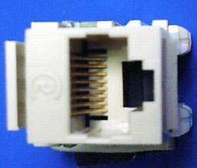
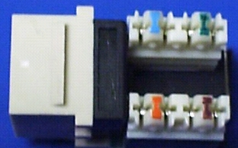
RJ-45 Jack
The jack is the female component in a network device, wall outlet, or patch panel
Punch-down connections at the back of the jack where the Ethernet UTP cable connects.
Notes:
The jack is the female component in a network device, wall outlet, or patch panel as seen in Figure . Figure shows the punch-down connections at the back of the jack where the Ethernet UTP cable connects.

Slide 12
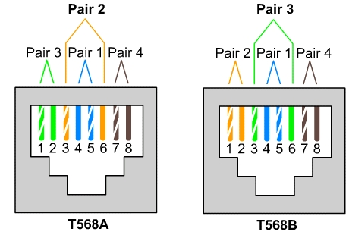
UTP Implementation
Notes:
For electricity to run between the connector and the jack, the order of the wires must follow EIA/TIA-T568-A or T568-B standards, as shown in Figure . Identify the correct EIA/TIA category of cable to use for a connecting device by determining what standard is being used by the jack on the network device. In addition to identifying the correct EIA/TIA category of cable, determine whether to use a straight-through cable or a crossover cable.

Slide 13
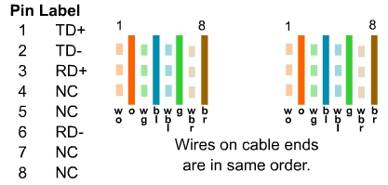
Straight-through Cable
Switch to router
Switch to PC or server
Hub to PC or server
Notes:
If the two RJ-45 connectors of a cable are held side by side in the same orientation, the colored wires will be seen in each. If the order of the colored wires is the same at each end, then the cable is straight-through as seen in Figure .

Slide 14
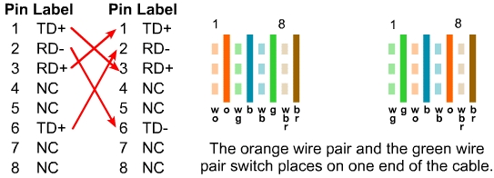
Cross-over Cable
Switch to switch
Switch to hub
Hub to hub
Router to router
PC to PC
Router to PC
Notes:
With crossover, the RJ-45 connectors on both ends show that some of the wires on one side of the cable are crossed to a different pin on the other side of the cable. Figure shows that pins 1 and 2 on one connector connect respectively to pins 3 and 6 on the other

Slide 15
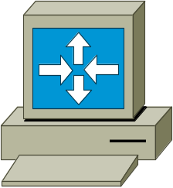
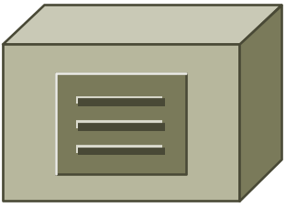
Repeaters
A repeater receives a sig., regenerates it
It can retime network signals at the bit
level to allow them to travel a longer
distance on the media
Notes:
The term repeater comes from the early days of long distance communication. The term describes the situation when a person on one hill would repeat the signal that was just received from the person on the previous hill. The process would repeat until the message arrived at its destination. Telegraph, telephone, microwave, and optical communications use repeaters to strengthen signals sent over long distances. A repeater receives a signal, regenerates it, and passes it on. It can regenerate and retime network signals at the bit level to allow them to travel a longer distance on the media. The Four Repeater Rule for 10-Mbps Ethernet should be used as a standard when extending LAN segments. This rule states that no more than four repeaters can be used between hosts on a LAN. This rule is used to limit latency added to frame travel by each repeater. Too much latency on the LAN increases the number of late collisions and makes the LAN less efficient.

Slide 16
Hubs
Passive
  A passive hub serves as a physical connection point only.
  It does not manipulate or view the traffic that crosses it.
  It does not boost or clean the signal.
Active
  It needs power to amplify the incoming signal before passing it out to the other ports.
Intelligent
  These devices basically function as active hubs
  It also includes a microprocessor chip and diagnostic capabilities.
Notes:
Hubs are actually multiport repeaters. In many cases, the difference between the two devices is the number of ports that each provides. While a typical repeater has just two ports, a hub generally has from four to twenty-four ports. Hubs are most commonly used in Ethernet 10BASE-T or 100BASE-T networks, although there are other network architectures that use them as well.
Using a hub changes the network topology from a linear bus, where each device plugs directly into the wire, to a star. With hubs, data arriving over the cables to a hub port is electrically repeated on all the other ports connected to the same network segment, except for the port on which the data was sent.
Hubs come in three basic types:
Passive – A passive hub serves as a physical connection point only. It does not manipulate or view the traffic that crosses it. It does not boost or clean the signal. A passive hub is used only to share the physical media. As such, the passive hub does not need electrical power.
Active – An active hub must be plugged into an electrical outlet because it needs power to amplify the incoming signal before passing it out to the other ports.
Intelligent – Intelligent hubs are sometimes called smart hubs. These devices basically function as active hubs, but also include a microprocessor chip and diagnostic capabilities. Intelligent hubs are more expensive than active hubs, but are useful in troubleshooting situations.
Devices attached to a hub receive all traffic traveling through the hub. The more devices there are attached to the hub, the more likely there will be collisions. A collision occurs when two or more workstations send data over the network wire at the same time. All data is corrupted when that occurs. Every device connected to the same network segment is said to be a member of a collision domain.
Sometimes hubs are called concentrators, because hubs serve as a central connection point for an Ethernet LAN.

Slide 17
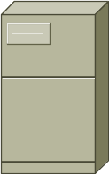
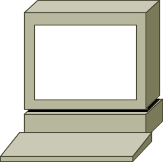
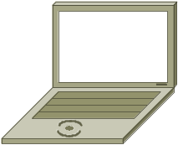
Wireless
Access Points
Server
Desktop
Laptop
Notes:
A wireless network can be created with much less cabling than other networks. Wireless signals are electromagnetic waves that travel through the air. Wireless networks use Radio Frequency (RF), laser, infrared (IR), or satellite/microwaves to carry signals from one computer to another without a permanent cable connection. The only permanent cabling can be to the access points for the network. Workstations within the range of the wireless network can be moved easily without connecting and reconnecting network cabling. A common application of wireless data communication is for mobile use. Some examples of mobile use include commuters, airplanes, satellites, remote space probes, space shuttles, and space stations.
At the core of wireless communication are devices called transmitters and receivers. The transmitter converts source data to electromagnetic (EM) waves that are passed to the receiver. The receiver then converts these electromagnetic waves back into data for the destination. For two-way communication, each device requires a transmitter and a receiver. Many networking device manufacturers build the transmitter and receiver into a single unit called a transceiver or wireless network card. All devices in wireless LANs (WLANs) must have the appropriate wireless network card installed. The two most common wireless technologies used for networking are IR and RF. IR technology has its weaknesses. Workstations and digital devices must be in the line of sight of the transmitter in order to operate. An infrared-based network suits environments where all the digital devices that require network connectivity are in one room. IR networking technology can be installed quickly, but the data signals can be weakened or obstructed by people walking across the room or by moisture in the air. There are, however, new IR technologies being developed that can work out of sight. Radio Frequency technology allows devices to be in different rooms or even buildings. The limited range of radio signals restricts the use of this kind of network. RF technology can be on single or multiple frequencies. A single radio frequency is subject to outside interference and geographic obstructions. Furthermore, a single frequency is easily monitored by others, which makes the transmissions of data insecure. Spread spectrum avoids the problem of insecure data transmission by using multiple frequencies to increase the immunity to noise and to make it difficult for outsiders to intercept data transmissions. Two approaches currently being used to implement spread spectrum for WLAN transmissions are Frequency Hopping Spread Spectrum (FHSS) and Direct Sequence Spread Spectrum (DSSS). The technical details of how these technologies work are beyond the scope of this course.

Slide 18
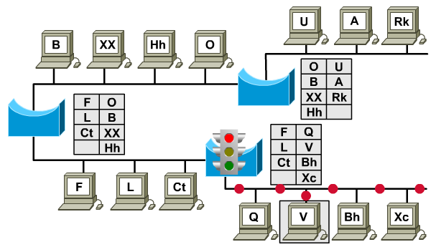
Bridges
Notes:
There are times when it is necessary to break up a large LAN into smaller, more easily managed segments. This decreases the amount of traffic on a single LAN and can extend the geographical area past what a single LAN can support. The devices that are used to connect network segments together include bridges, switches, routers, and gateways. Switches and bridges operate at the Data Link layer of the OSI model. The function of the bridge is to make intelligent decisions about whether or not to pass signals on to the next segment of a network.
When a bridge receives a frame on the network, the destination MAC address is looked up in the bridge table to determine whether to filter, flood, or copy the frame onto another segment. This decision process occurs as follows:
If the destination device is on the same segment as the frame, the bridge blocks the frame from going on to other segments. This process is known as filtering.
If the destination device is on a different segment, the bridge forwards the frame to the appropriate segment.
If the destination address is unknown to the bridge, the bridge forwards the frame to all segments except the one on which it was received. This process is known as flooding.
If placed strategically, a bridge can greatly improve network performance.

Slide 19
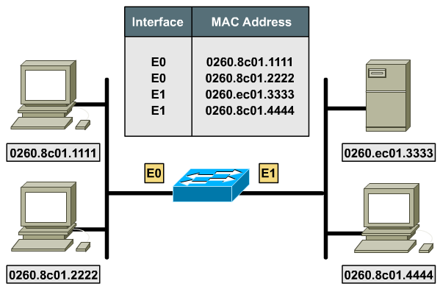
Switches
Notes:
A switch is sometimes described as a multiport bridge. While a typical bridge may have just two ports linking two network segments, the switch can have multiple ports depending on how many network segments are to be linked. Like bridges, switches learn certain information about the data packets that are received from various computers on the network. Switches use this information to build forwarding tables to determine the destination of data being sent by one computer to another computer on the network.
Although there are some similarities between the two, a switch is a more sophisticated device than a bridge. A bridge determines whether the frame should be forwarded to the other network segment based on the destination MAC address. A switch has many ports with many network segments connected to them. A switch chooses the port to which the destination device or workstation is connected. Ethernet switches are becoming popular connectivity solutions because, like bridges, switches improve network performance by improving speed and bandwidth.
Switching is a technology that alleviates congestion in Ethernet LANs by reducing the traffic and increasing the bandwidth. Switches can easily replace hubs because switches work with existing cable infrastructures. This improves performance with a minimum of intrusion into an existing network.
In data communications today, all switching equipment performs two basic operations. The first operation is called switching data frames. Switching data frames is the process by which a frame is received on an input medium and then transmitted to an output medium. The second is the maintenance of switching operations where switches build and maintain switching tables and search for loops.
Switches operate at much higher speeds than bridges and can support new functionality, such as virtual LANs.

Slide 20
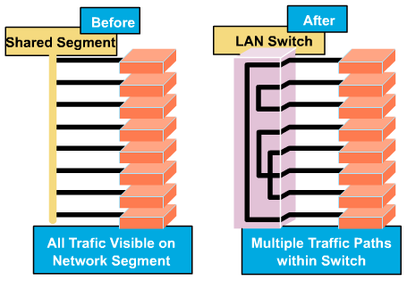
Micro-segmentation
Notes:
An Ethernet switch has many benefits. One benefit is that an Ethernet switch allows many users to communicate in parallel through the use of virtual circuits and dedicated network segments in a virtually collision-free environment. This maximizes the bandwidth available on the shared medium. Another benefit is that moving to a switched LAN environment is very cost effective because existing hardware and cabling can be reused.

Slide 21
Peer-to-peer
In a peer-to-peer network, networked computers act as equal partners, or peers
Individual users control their own resources
Peer-to-peer networks are relatively easy to install and operate
As networks grow, peer-to-peer relationships become increasingly difficult to coordinate
Notes:
By using LAN and WAN technologies, many computers are interconnected to provide services to their users. To accomplish this, networked computers take on different roles or functions in relation to each other. Some types of applications require computers to function as equal partners. Other types of applications distribute their work so that one computer functions to serve a number of others in an unequal relationship. In either case, two computers typically communicate with each other by using request/response protocols. One computer issues a request for a service, and a second computer receives and responds to that request. The requestor takes on the role of a client, and the responder takes on the role of a server. In a peer-to-peer network, networked computers act as equal partners, or peers. As peers, each computer can take on the client function or the server function. At one time, computer A may make a request for a file from computer B, which responds by serving the file to computer A. Computer A functions as client, while B functions as the server. At a later time, computers A and B can reverse roles.
In a peer-to-peer network, individual users control their own resources. The users may decide to share certain files with other users. The users may also require passwords before allowing others to access their resources. Since individual users make these decisions, there is no central point of control or administration in the network. In addition, individual users must back up their own systems to be able to recover from data loss in case of failures. When a computer acts as a server, the user of that machine may experience reduced performance as the machine serves the requests made by other systems.
Peer-to-peer networks are relatively easy to install and operate. No additional equipment is necessary beyond a suitable operating system installed on each computer. Since users control their own resources, no dedicated administrators are needed.
As networks grow, peer-to-peer relationships become increasingly difficult to coordinate. A peer-to-peer network works well with 10 or fewer computers. Since peer-to-peer networks do not scale well, their efficiency decreases rapidly as the number of computers on the network increases. Also, individual users control access to the resources on their computers, which means security may be difficult to maintain. The client/server model of networking can be used to overcome the limitations of the peer-to-peer network.

Slide 22
Client/server
network services are located on a dedicated computer called a server
Servers are designed to handle requests from many clients simultaneously
Data generated is easier to back-up and maintain
Some disadvantages
  It also incurs some costs.
  The server introduces a single point of failure into the network.
  Servers require a trained, expert staff to administer and maintain.
  Server systems also require additional hardware and specialized software that add to the cost.
Notes:
In a client/server arrangement, network services are located on a dedicated computer called a server. The server responds to the requests of clients. The server is a central computer that is continuously available to respond to requests from clients for file, print, application, and other services. Most network operating systems adopt the form of a client/server relationship. Typically, desktop computers function as clients and one or more computers with additional processing power, memory, and specialized software function as servers.
Servers are designed to handle requests from many clients simultaneously. Before a client can access the server resources, the client must be identified and be authorized to use the resource. This is done by assigning each client an account name and password that is verified by an authentication service. The authentication service acts as a sentry to guard access to the network. With the centralization of user accounts, security, and access control, server-based networks simplify the administration of large networks.
The concentration of network resources such as files, printers, and applications on servers also makes the data generated easier to back-up and maintain. Rather than having these resources spread around individual machines, resources can be located on specialized, dedicated servers for easier access. Most client/server systems also include facilities for enhancing the network by adding new services that extend the usefulness of the network.
The distribution of functions in the client/server networks brings substantial advantages, but it also incurs some costs. Although the aggregation of resources on server systems brings greater security, simpler access and coordinated control, the server introduces a single point of failure into the network. Without an operational server, the network cannot function at all. Servers require a trained, expert staff to administer and maintain. This increases the expense of running the network. Server systems also require additional hardware and specialized software that add to the cost.

Slide 23
CABLING THE WAN

Slide 24
WAN Physical Layer
The physical layer implementations vary depending on the distance of the equipment from the services, the speed and the type of service itself
Cisco HDLC
PPP
Frame Relay
ISDN BRI (with PPP)
DSL Modem
Cable Modem
EIA/TIA-232
EIA/TIA-449
X.21, V.24
V.35, HSSI
RJ-45
Note: ISDN BRI cable
pinouts are different
than the pinouts of
Ethernet
RJ-11
Note: works
over telephone
line
BNC
Note: works
over
TV line
Notes:
The physical layer implementations vary depending on the distance of the equipment from the services, the speed, and the type of service itself. Serial connections are used to support WAN services such as dedicated leased lines that run Point-to-Point Protocol (PPP) or Frame Relay. The speed of these connections ranges from 2400 bits per second (bps) to T1 service at 1.544 megabits per second (Mbps) and E1 service at 2.048 megabits per seconds (Mbps).
ISDN offers dial-on-demand connections or dial backup services. An ISDN Basic Rate Interface (BRI) is composed of two 64 kbps bearer channels (B channels) for data, and one delta channel (D channel) at 16 kbps used for signaling and other link-management tasks. PPP is typically used to carry data over the B channels.
With the increasing demand for residential broadband high-speed services, DSL and cable modem connections are becoming more popular. For example, typical residential DSL service can achieve T1/E1 speeds over the existing telephone line. Cable services use the existing coaxial cable TV line. A coaxial cable line provides high-speed connectivity matching or exceeding that of DSL. DSL and cable modem service will be covered in more detail in a later module.

Slide 25
WAN Serial Connections
WANs use serial transmission.
Two of serial connections are a 60-pin connector and a more compact ‘smart serial’ connector
A device providing clocking rate is data communications equipment (DCE) and use a DCE cable.
If the connection is made directly to a device that provides signal clocking, the router will be a data terminal equipment (DTE) and use a DTE serial cable.
Notes:
For long distance communication, WANs use serial transmission. This is a process by which bits of data are sent over a single channel. This process provides more reliable long distance communication and the use of a specific electromagnetic or optical frequency range. Frequencies are measured in terms of cycles per second and expressed in Hertz (Hz). Signals transmitted over voice grade telephone lines use 4 kilohertz (kHz). The size of the frequency range is referred to as bandwidth. In networking, bandwidth is a measure of the bits per second that are transmitted.
For a Cisco router, physical connectivity at the customer site is provided by one of two types of serial connections. The first type of serial connections is a 60-pin connector. The second is a more compact ‘smart serial’ connector. The provider connector will vary depending on the type of service equipment.
If the connection is made directly to a service provider, or a device that provides signal clocking such as a channel/data service unit (CSU/DSU), the router will be a data terminal equipment (DTE) and use a DTE serial cable. Typically this is the case. However, there are occasions where the local router is required to provide the clocking rate and therefore will use a data communications equipment (DCE) cable. In the curriculum router labs one of the connected routers will need to provide the clocking function. Therefore, the connection will consist of a DCE and a DTE cable

Slide 26
Routers and Serial Connections
Data Terminal Equipment
End of user’s device
on the WAN link
Data Communications Equipment
End of provider’s site
Of communication facility
Responsible for clocking
Frame Relay
CSU/DSU
CSU/DSU
DTE
DCE
DCE
DTE
it is necessary to determine whether DTE or DCE connectors are required.
DCE like CSU/DSU will perform signal clocking
Notes:
Routers are responsible for routing data packets from source to destination within the LAN, and for providing connectivity to the WAN. Within a LAN environment the router contains broadcasts, provides local address resolution services, such as ARP and RARP, and may segment the network using a subnetwork structure. In order to provide these services the router must be connected to the LAN and WAN.
In addition to determining the cable type, it is necessary to determine whether DTE or DCE connectors are required. The DTE is the endpoint of the user’s device on the WAN link. The DCE is typically the point where responsibility for delivering data passes into the hands of the service provider.
When connecting directly to a service provider, or to a device such as a CSU/DSU that will perform signal clocking, the router is a DTE and needs a DTE serial cable. This is typically the case for routers. However, there are cases when the router will need to be the DCE. When performing a back-to-back router scenario in a test environment, one of the routers will be a DTE and the other will be a DCE. Routers are responsible for routing data packets from source to destination within the LAN, and for providing connectivity to the WAN. Within a LAN environment the router contains broadcasts, provides local address resolution services, such as ARP and RARP, and may segment the network using a subnetwork structure. In order to provide these services the router must be connected to the LAN and WAN.
In addition to determining the cable type, it is necessary to determine whether DTE or DCE connectors are required. The DTE is the endpoint of the user’s device on the WAN link. The DCE is typically the point where responsibility for delivering data passes into the hands of the service provider.
When connecting directly to a service provider, or to a device such as a CSU/DSU that will perform signal clocking, the router is a DTE and needs a DTE serial cable. This is typically the case for routers. However, there are cases when the router will need to be the DCE. When performing a back-to-back router scenario in a test environment, one of the routers will be a DTE and the other will be a DCE.

Slide 27
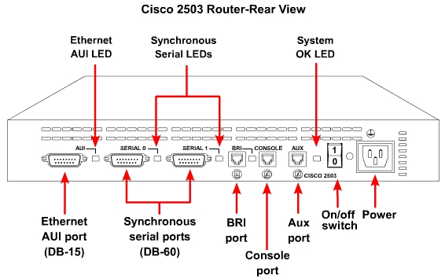
Fixed Module Router
Notes:
When cabling routers for serial connectivity, the routers will either have fixed or modular ports. The type of port being used will affect the syntax used later to configure each interface.
Interfaces on routers with fixed serial ports are labeled for port type and port number in figure above

Slide 28
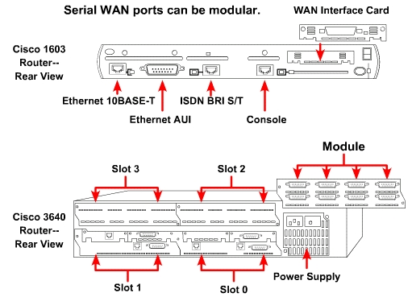
Module Router
Notes:
Interfaces on routers with modular serial ports are labeled for port type, slot, and port number. The slot is the location of the module. To configure a port on a modular card, it is necessary to specify the interface using the syntax “port type slot number/port number.” Use the label “serial 1/0,” when the interface is serial, the slot number where the module is installed is slot 1, and the port that is being referenced is port 0.

Slide 29
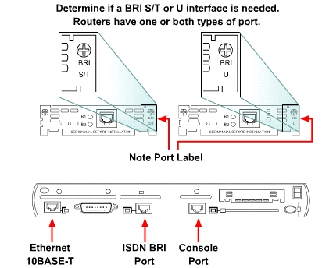
Routers and ISDN BRI Connections
Notes:
With ISDN BRI, two types of interfaces may be used, BRI S/T and BRI U. Determine who is providing the Network Termination 1 (NT1) device in order to determine which interface type is needed. An NT1 is an intermediate device located between the router and the service provider ISDN switch. The NT1 is used to connect four-wire subscriber wiring to the conventional two-wire local loop. In North America, the customer typically provides the NT1, while in the rest of the world the service provider provides the NT1 device.
It may be necessary to provide an external NT1 if the device is not already integrated into the router. Reviewing the labeling on the router interfaces is usually the easiest way to determine if the router has an integrated NT1. A BRI interface with an integrated NT1 is labeled BRI U. A BRI interface without an integrated NT1 is labeled BRI S/T. Because routers can have multiple ISDN interface types, determine which interface is needed when the router is purchased. The type of BRI interface may be determined by looking at the port label. To interconnect the ISDN BRI port to the service-provider device, use a UTP Category 5 straight-through cable.
Caution: It is important to insert the cable running from an ISDN BRI port only to an ISDN jack or an ISDN switch. ISDN BRI uses voltages that can seriously damage non-ISDN devices.

Slide 30
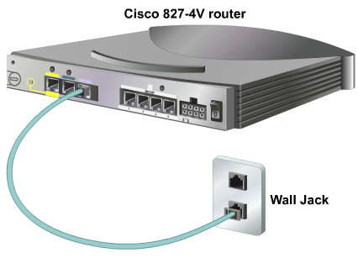
Routers and DSL Connections
The Cisco 827 ADSL router has one asymmetric digital subscriber line (ADSL) interface.
To connect an ADSL line to the ADSL port on a router
Notes:
The Cisco 827 ADSL router has one asymmetric digital subscriber line (ADSL) interface. To connect an ADSL line to the ADSL port on a router, do the following:
Connect the phone cable to the ADSL port on the router.
Connect the other end of the phone cable to the phone jack.
To connect a router for DSL service, use a phone cable with RJ-11 connectors. DSL works over standard telephone lines using pins 3 and 4 on a standard RJ-11 connector.

Slide 31
Routers and DSL Connections
The Cisco 827 ADSL router has one asymmetric digital subscriber line (ADSL) interface.
To connect an ADSL line to the ADSL port on a router, do the following:
  Connect the phone cable to the ADSL port on the router.
  Connect the other end of the phone cable to the phone jack.
  To connect a router for DSL service, use a phone cable with RJ-11 connectors. DSL works over standard telephone lines using pins 3 and 4 on a standard RJ-11 connector.
Notes:
The Cisco 827 ADSL router has one asymmetric digital subscriber line (ADSL) interface. To connect an ADSL line to the ADSL port on a router, do the following:
Connect the phone cable to the ADSL port on the router.
Connect the other end of the phone cable to the phone jack.
To connect a router for DSL service, use a phone cable with RJ-11 connectors. DSL works over standard telephone lines using pins 3 and 4 on a standard RJ-11 connector.

Slide 32
Routers and Cable Connections
Use the following steps to connect the Cisco uBR905 cable access router to the cable system:
  Verify that the router is not connected to power.
  Locate the RF coaxial cable coming from the coaxial cable (TV) wall outlet.
  Install a cable splitter/directional coupler, if needed, to separate signals for TV and computer use.
  Connect the coaxial cable to the F connector of the router. Hand-tighten the connector, making sure that it is finger-tight, and then give it a 1/6 turn with a wrench.
  Make sure that all other coaxial cable connectors, all intermediate splitters, couplers, or ground blocks, are securely tightened from the distribution tap to the Cisco uBR905 router.
Notes:
The Cisco uBR905 cable access router provides high-speed network access on the cable television system to residential and small office, home office (SOHO) subscribers. The uBR905 router has a coaxial cable, or F-connector, interface that connects directly to the cable system. Coaxial cable and a BNC connector are used to connect the router and cable system. Use the following steps to connect the Cisco uBR905 cable access router to the cable system:
Verify that the router is not connected to power.
Locate the RF coaxial cable coming from the coaxial cable (TV) wall outlet.
Install a cable splitter/directional coupler, if needed, to separate signals for TV and computer use. If necessary, also install a high-pass filter to prevent interference between the TV and computer signals.
Connect the coaxial cable to the F connector of the router. Hand-tighten the connector, making sure that it is finger-tight, and then give it a 1/6 turn with a wrench.
Make sure that all other coaxial cable connectors, all intermediate splitters, couplers, or ground blocks, are securely tightened from the distribution tap to the Cisco uBR905 router.
Caution: Do not over tighten the connector. Over tightening may break off the connector. Do not use a torque wrench because of the danger of tightening the connector more than the recommended 1/6 turns after it is finger-tight

Slide 33
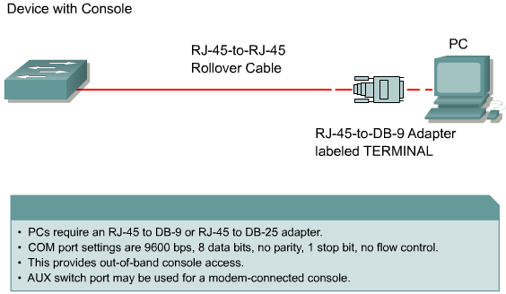
Setting up Console Connections

Slide 34
Setting up Console Connections
Connect the devices using a rollover cable from the router console port to the workstation serial port.
An RJ-45-to-DB-9 or an RJ-45-to-DB-25 adapter may be required for the PC or terminal.
Next, configure the terminal emulation application with the following common equipment (COM) port settings: 9600 bps, 8 data bits, no parity, 1 stop bit, and no flow control.
The AUX port is used to provide out-of-band management through a modem. The AUX port must be configured by way of the console port before it can be used. The AUX port also uses the settings of 9600 bps, 8 data bits, no parity, 1 stop bit, and no flow control.

Slide 35

Summary
Use a crossover cable to connect between two similar devices, such as switches, routers, PCs, and hubs.
Use a straight-through cable to connect between different devices.
WANs use serial data transmission. WAN connection types include ISDN, DSL, and cable modems.
A router is usually the DTE and needs a serial cable to connect to a DCE device like a CSU/DSU.
The ISDN BRI has two types of interfaces, S/T and U interfaces
Rollover cable is used to connect a terminal and the console port of an internetworking device

Slide 36

Q&A
Notes:
_________________________________________________________________________
_________________________________________________________________________
_________________________________________________________________________
_________________________________________________________________________
_________________________________________________________________________
_________________________________________________________________________
_________________________________________________________________________
_________________________________________________________________________
_________________________________________________________________________
_________________________________________________________________________
_________________________________________________________________________
_________________________________________________________________________
_________________________________________________________________________
_________________________________________________________________________
_________________________________________________________________________
_________________________________________________________________________
_________________________________________________________________________
_________________________________________________________________________
_________________________________________________________________________

Slide 37
Enjoy the Course
Notes:
_________________________________________________________________________
_________________________________________________________________________
_________________________________________________________________________
_________________________________________________________________________
_________________________________________________________________________
_________________________________________________________________________
_________________________________________________________________________
_________________________________________________________________________
_________________________________________________________________________
_________________________________________________________________________
_________________________________________________________________________
_________________________________________________________________________
_________________________________________________________________________
_________________________________________________________________________
_________________________________________________________________________
_________________________________________________________________________
_________________________________________________________________________
_________________________________________________________________________
_________________________________________________________________________

